Slide 1
Welcome to
The AMOS Demo Day!
Prof. Dr. Dirk Riehle
Univ. Erlangen
AMOS H02
Licensed under CC BY 4.0 International
Notes:
It is Friedrich-Alexander University Erlangen-Nürnberg – FAU, in short.
Corporate identity wants us to say “Friedrich-Alexander University”.

Slide 2
Welcome to
The AMOS Demo Day!
Dirk Riehle / Theo Vassiliou-Gioles
Univ. Erlangen / TU Berlin
AMOS H02
Licensed under CC BY 4.0 International
Notes:
It is Friedrich-Alexander University Erlangen-Nürnberg – FAU, in short.
Corporate identity wants us to say “Friedrich-Alexander University”.

Slide 3
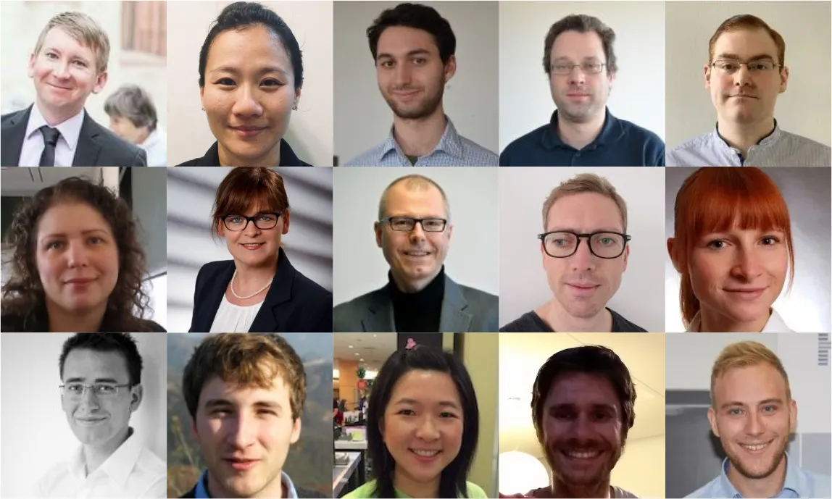
The Professorship for Open Source Software

Slide 4
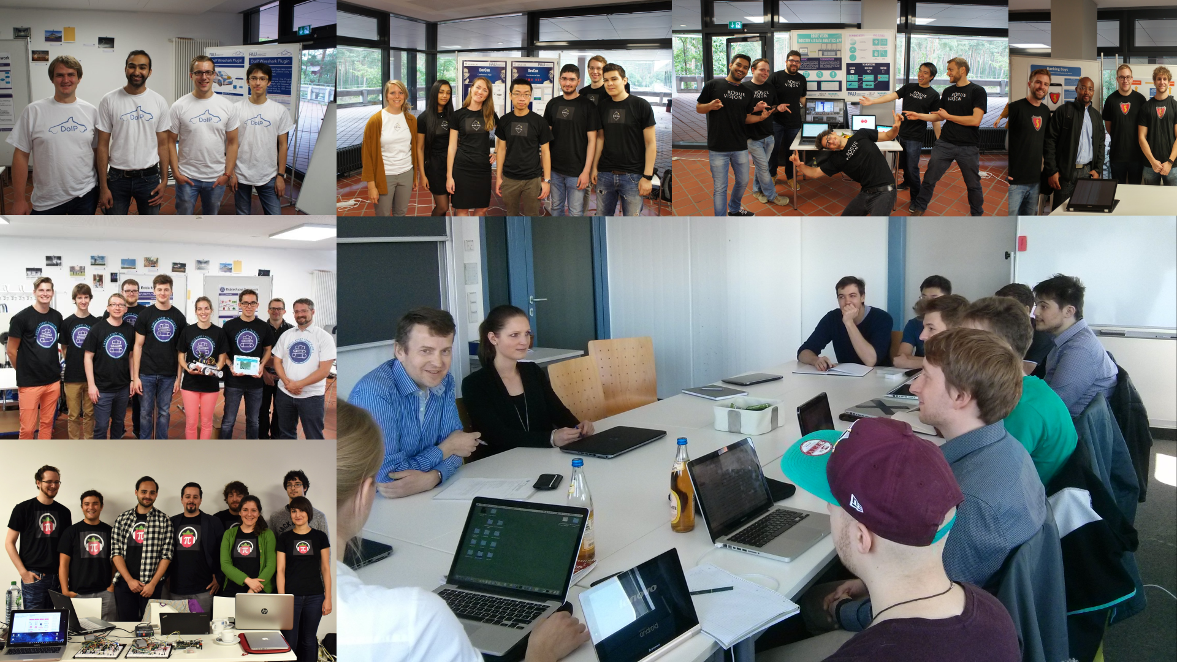
Studen Teams

Slide 5



















Industry Partners and Teaching Projects
...

Slide 6
The Summer Semester 2022 AMOS Projects
...
Notes:
These are the available projects; at start of course, students will already have been assigned to teams and projects.

Slide 7
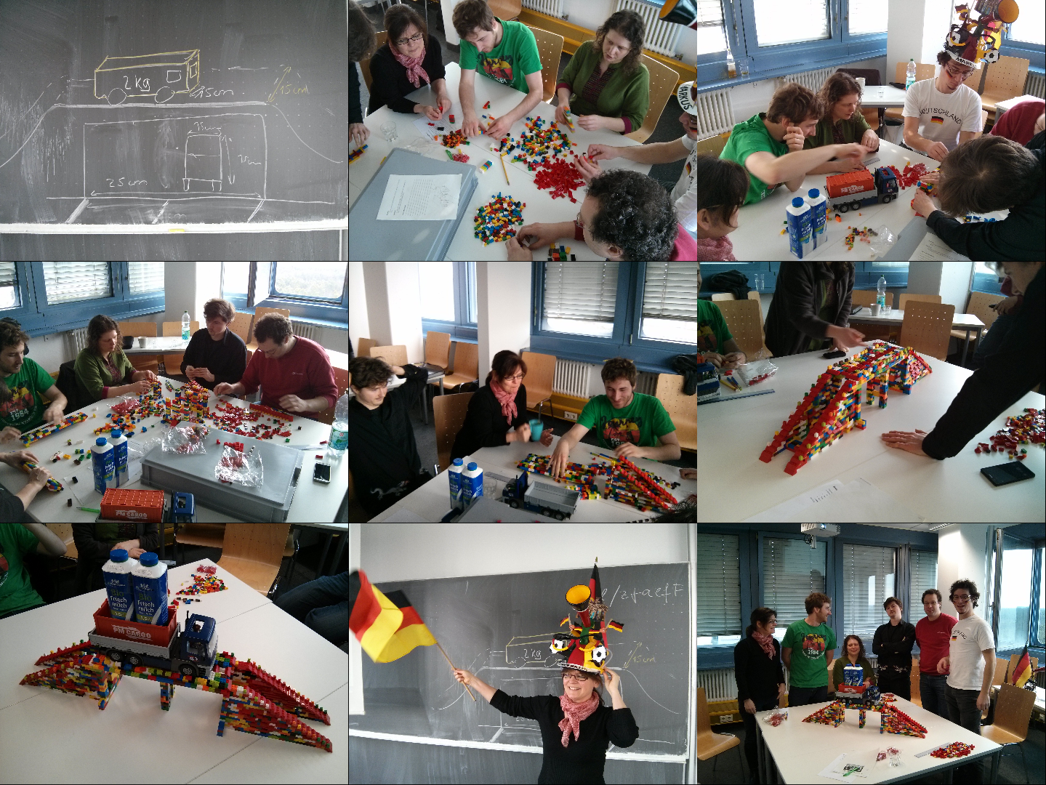

Slide 8
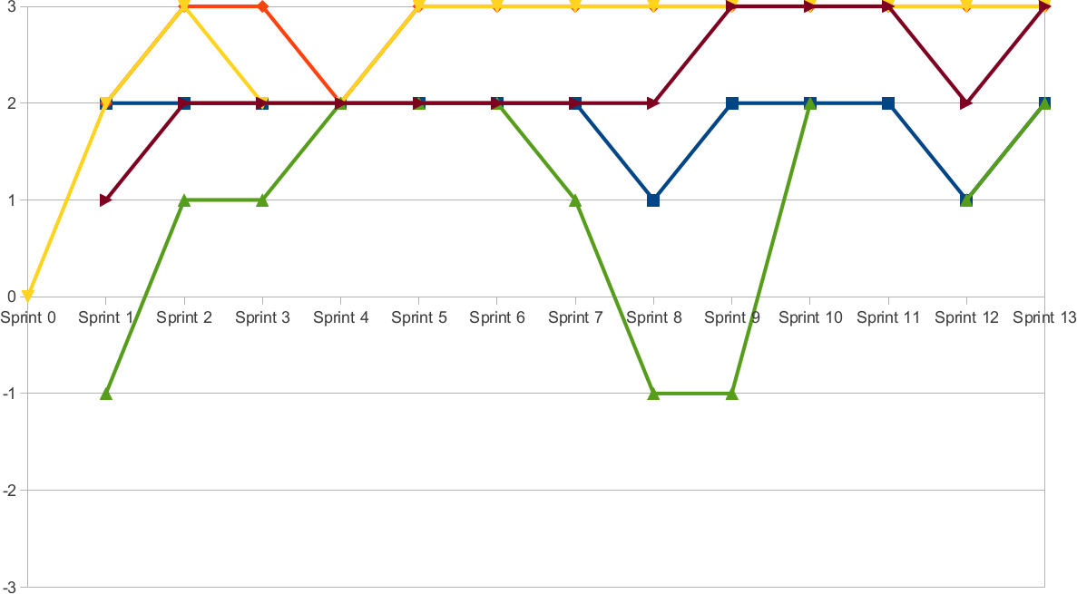
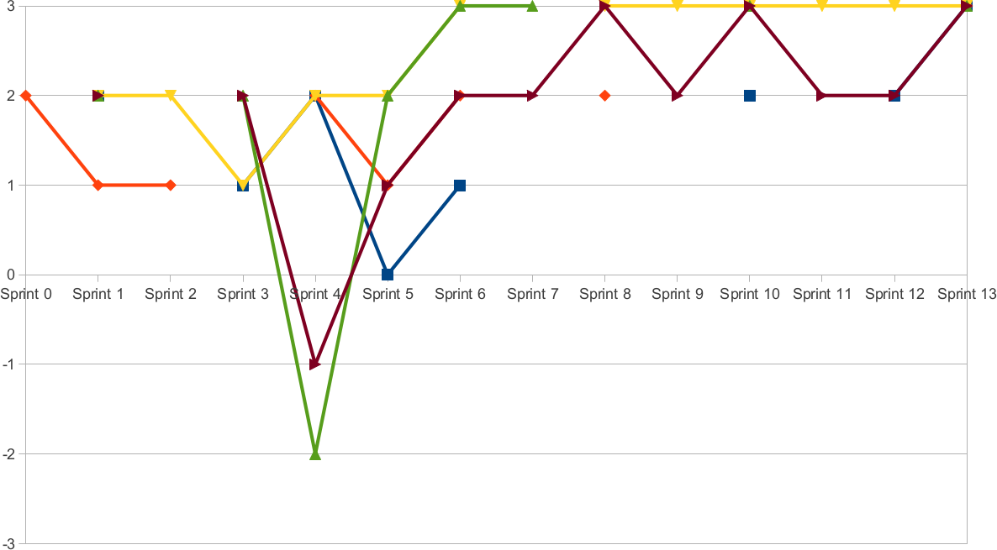
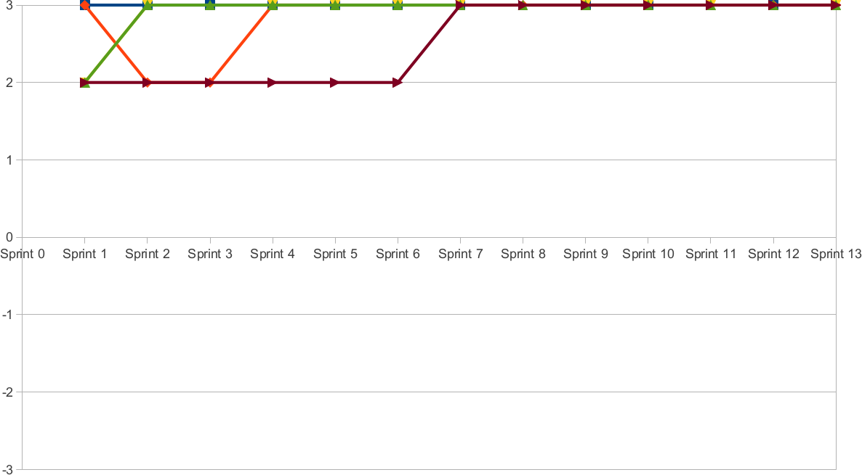

Slide 9
Project Slides
Project slides

Slide 10
Demo Day Schedule
Schedule

Slide 11
Let the Demos Commmence!
Please choose a room at
https://demos.uni1.de

Slide 12
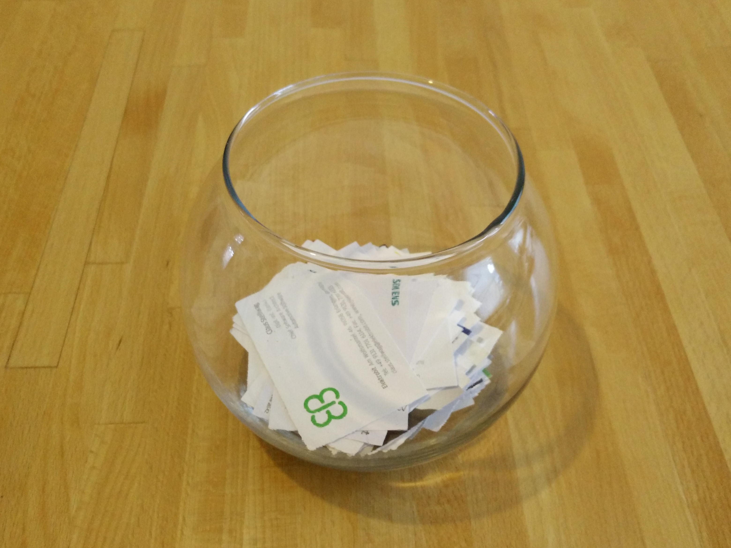

Slide 13
Thank you! Questions?
dirk.riehle@fau.de – https://oss.cs.fau.dedirk@riehle.org – https://dirkriehle.com – @dirkriehle
DR

Slide 14
Legal Notices
License
  Licensed under the CC BY 4.0 International license
Copyright
  © 2010-2022 Dirk Riehle, some rights reserved

